Slide 1
Bristol, North Somerset & South Gloucestershire Integrated Care System Partnership Day October 2022
Sharing our thinking
and next steps

Slide 2
Bristol, North Somerset & South Gloucestershire Integrated Care System Partnership Day October 2022
Contents
Executive Summary | p3
Introductions | p8
Session 1: Exploring the opportunities and challenges for our partnership | p11
Session 2: Working together as a partnership | p17
Session 3: Focussing our strategy | p23
Panel discussion, Q&A and next steps | p32
This pack is intended to capture some of the main themes from our partnership day. It is, at best, a high-level reflection of the many individual and shared conversations and connections; and could never hope to contain all the insights and contributions from across over 200 participants and the four core sessions from the day. However, it is designed to help share and build on that thinking, and the spirit of collaboration, as we as a partnership develop our shared strategy and deliver on our plans.
As such, this is represents the start of a conversation, not the end – one less about “you said, we did” and more “we said, we did”. Feedback on the day welcomed the coming together across our public services and voluntary & community sector, but also recognised the need to continue to reach out more broadly if we are to address long-standing inequalities in our system and our places.
In this spirit, all comments, queries, suggestions and further reflections are welcome at any time.

Slide 3
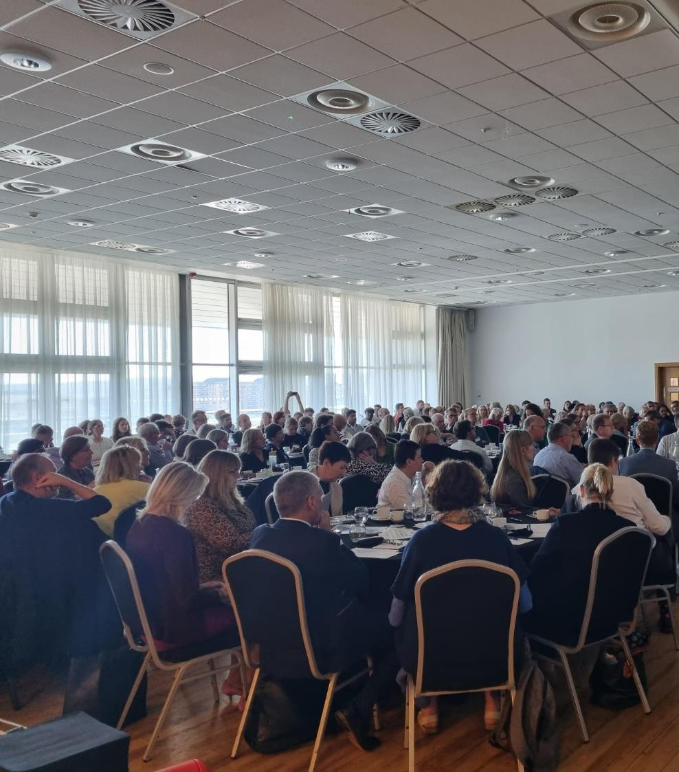
Partnership Day
Executive Summary

Slide 4
Executive Summary: what, where, who and when
Over 200 participants from 88 different organisations across the health, local government, and the voluntary & community sectors in Bristol, North Somerset and South Gloucestershire joined the ICS Partnership day held on 18th October 2022 in Weston-Super-Mare.
3 facilitated sessions were held focussing on:
The opportunities and challenges for our partnership
Working together as a partnership
Future strategic focus areas
Our panel discussion and Q&A included:
Chris Sivers (South Gloucestershire Council)
Christina Gray (Bristol City Council)
Huda Hajinur (Caafi Health)
Jo Walker (North Somerset Council)
John Heather (Pier Health Group)
Maria Kane (North Bristol Trust)
Sado Jirde (Black South West Network)
Shane Devlin (BNSSG ICB)

Slide 5
Executive Summary: some headline messages from the day
A major theme that emerged from the day was “bravery”:
of patients, carers, communities, staff and volunteers in enduring the pandemic, the cost-of-living crisis and in facing the winter to come; but also in having the courage to address the inequalities and challenges impacting all parts of our system, and to harness this opportunity as a licence to think and act differently.
COVID provided us with a “common enemy” and shared focus.
How can we recreate this sense of shared urgency? There are no shortage of crises, but if we are to make a difference, we need to have a small number of very clear priorities, and tangible things that we are all working together on.
There is a need to move away from some elements of current culture – including the “blame game”.
This is not to say that people should not highlight when things go wrong or need to change. However, it is about how we respond positively to the opportunities we identify, how we accept a degree of risk and that we will sometimes fail in order to succeed, giving people the benefit of the doubt and new ideas a proper chance to succeed – recognising that we cannot continue to work in the same way as we have historically.
We are starting to see a shift from thinking about medical needs in isolation, to considering social support and wellbeing.
Strong and sustainable clinical services are critical to our success and to addressing health inequalities. However, the day further emphasised the role of the voluntary & community sector, individuals and communities themselves in co-creation (built on mutual respect and power-sharing) and expanding the role of social prescribing and wider support to people’s wellbeing, to address our longstanding health inequalities.
Support to children and young people was one of the most discussed topics of the day.
There is a need to ensure that their physical and mental health is a core part of our plans, including looking at family-based approaches to improving population health and wellbeing.
A key enabler and success factor will be our ability to move money and resources “upstream”.
This means ensuring that we support commitments to addressing the causes and the effects of poor physical and mental health with a shared focus on prevention of disease as well as helping people living with long-term conditions to stay independent and well.

Slide 6
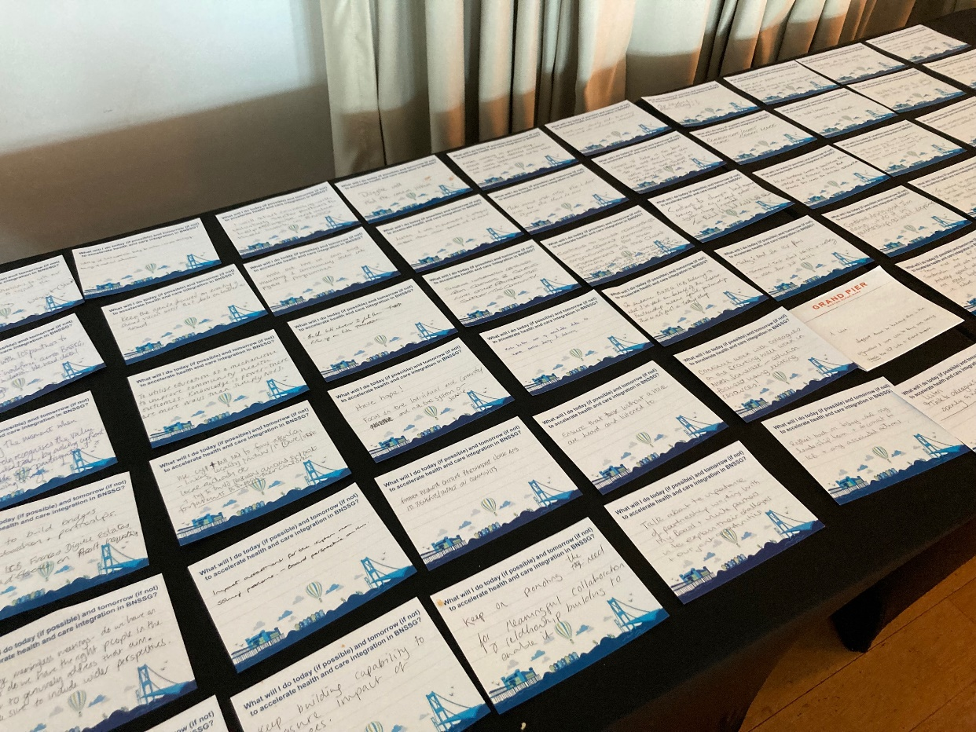
Executive Summary: our pledges
75 attendees made specific pledges to do one thing today if possible, tomorrow if not, to accelerate health and care integration in BNSSG. Examples included:
“To utilise education as a mechanism to improve community health outcomes. Knowledge is power - there are more ways than simply NHS.”
“Talk about
the importance of partnership working with the board and unite partners in and explain their challenges and our joint opportunities.”
“Build links wherever I find them. TODAY. Follow up on links. TOMORROW.“
“To keep voicing the needs of the VCSE sector and working with communities to put forward their needs.”
“Educate people to look after their health and wellbeing and give them a sense of empowerment. Communicate and explain that places better-create 'ownership' within community.”

Slide 7
Executive Summary: feedback and impact
Participants were surveyed before and after the event, and asked about their level of confidence, engagement and optimism. Responses highlighted that:
The partnership day led to increased confidence in participants’ knowledge and understanding of the challenges facing the BNSSG partnership, with 90% of respondents feeling “very” or “moderately” confident after the event.
Engagement with the BNSSG partnership also improved after the day, with 39% of respondents feeling “very engaged” compared to 32% before the event. An increased proportion of respondents felt moderately confident, and no respondents felt “not at all confident” in working collaboratively with other system partners after the event.
Support for the statement "I'm optimistic the BNSSG integrated care partnership will enable us to do things differently than before; delivering more joined-up, preventative, and person-centred care for our whole population" increased and disagreement reduced (with zero respondents strongly disagreeing).

Slide 8
Partnership Day
Introductions

Slide 9
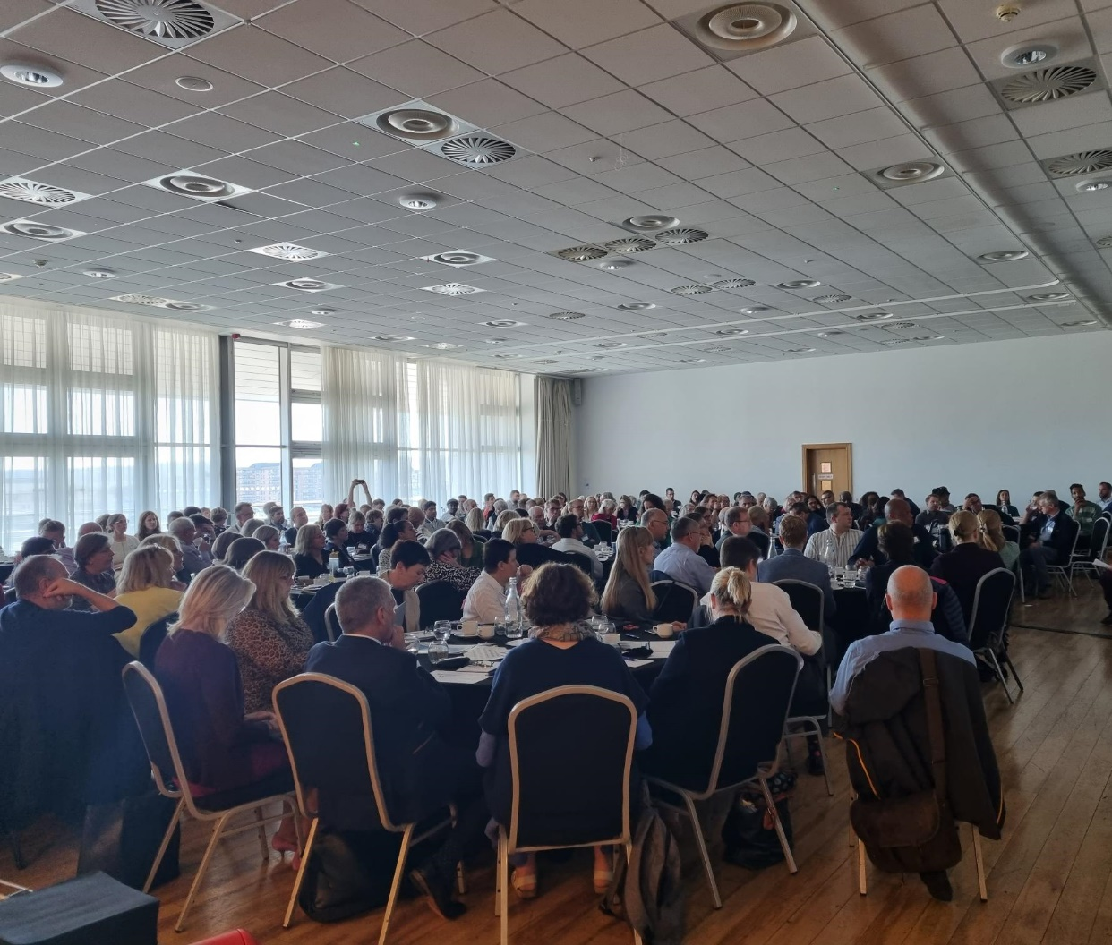
Partnership Day: A time for bravery
Councillor Mike Bell (Deputy Leader and Executive Member for Adult Services, Health and Housing at North Somerset Council; Chair of the Health & Wellbeing Board and Integrated Care Partnership) opened the day, welcoming participants.
Mike highlighted how the Partnership Day was an opportunity to engage in the development and delivery of our integrated care strategy for Bristol, North Somerset and South Gloucestershire.
The day had specific aims: ∙ to widen participation ∙ to build shared understanding; and ∙ to excite and galvanise attendees from across the integrated care system.
The day was, overall, a part of the journey: to define, describe and deliver the new strategy for BNSSG. Plenary sessions provided an update and an opportunity to consider the evidence, progress and thinking that has informed developments to-date; and smaller table discussions allowed participants an opportunity to reflect and share thoughts with colleagues from across BNSSG.

Slide 10
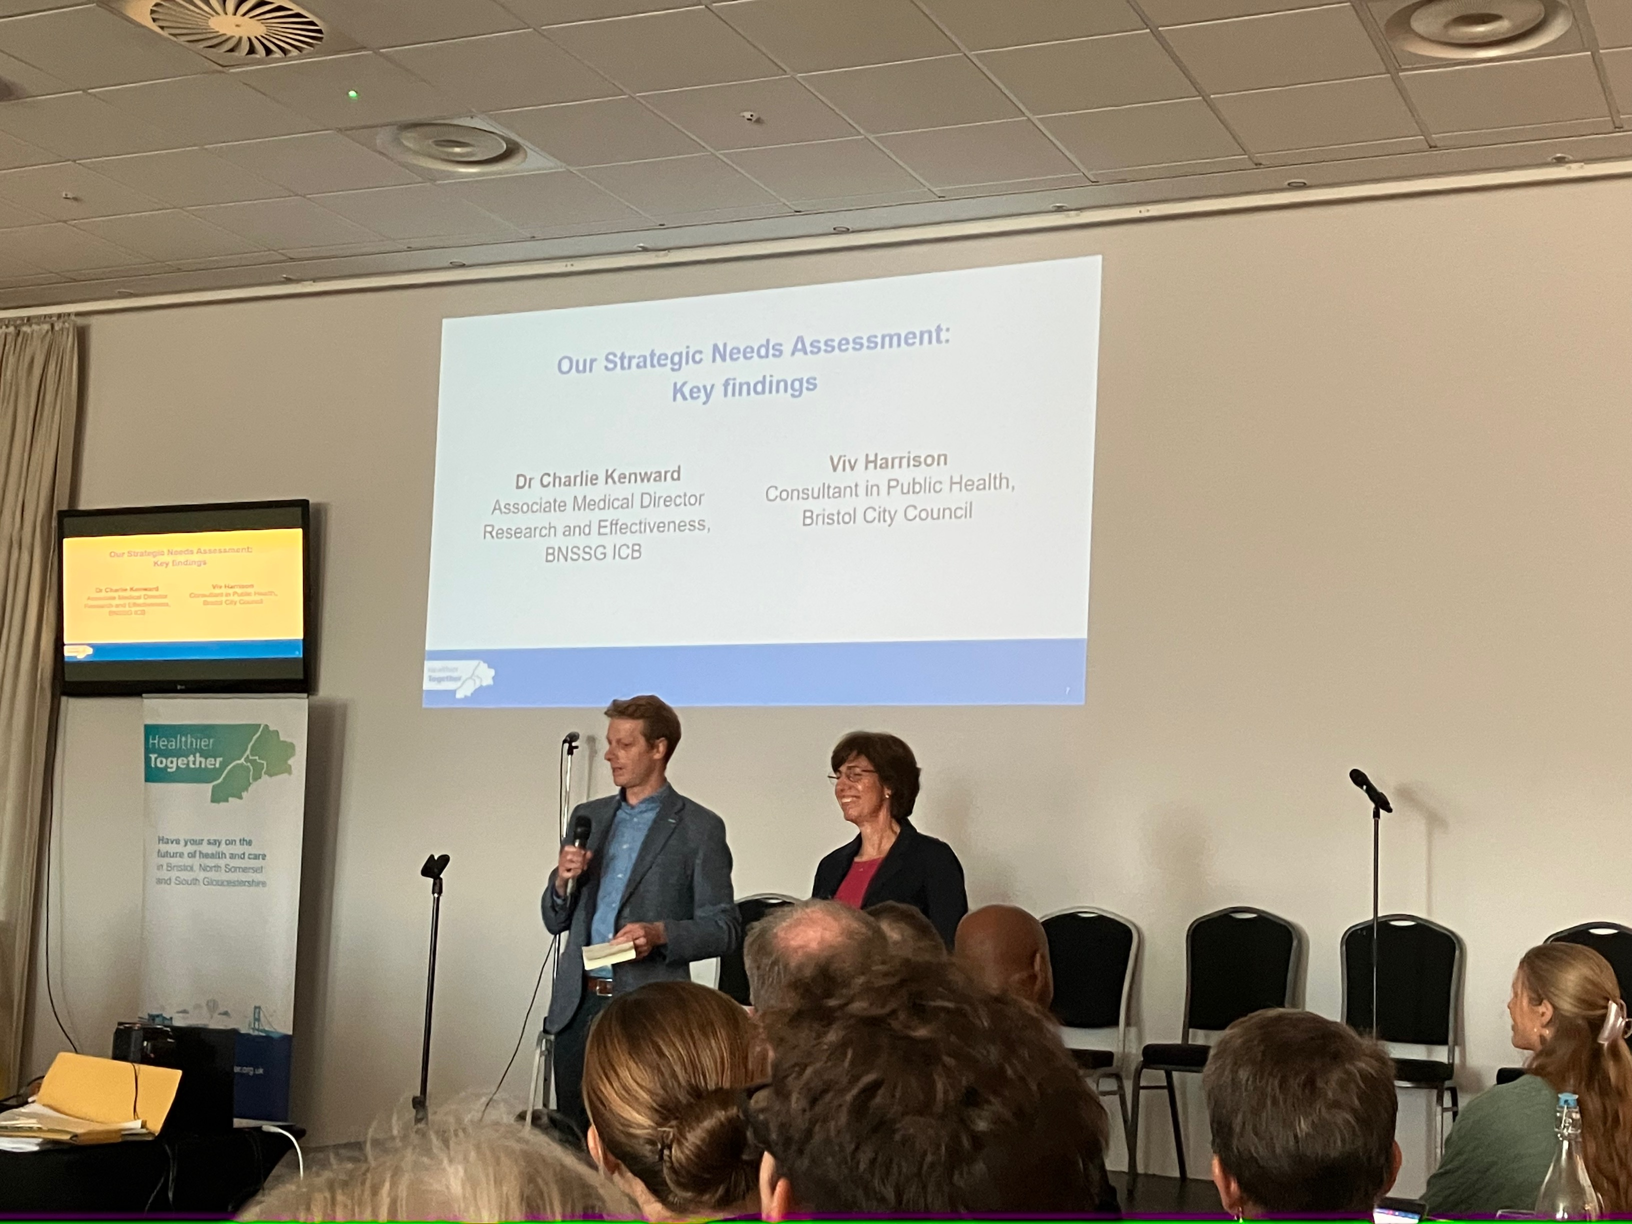
Strategic Needs Assessment: Key Findings
Dr Charlie Kenward (Associate Medical Director Research and Effectiveness, BNSSG ICB) and Dr Viv Harrison (Consultant in Public Health, Bristol City Council) walked participants through the findings from “Our Future Health”, the strategic needs assessment which has been developed for BNSSG. A full copy of the presentation is being shared separately. At the heart of the presentation were three priorities:
Prevention at each stage of life and every step of a care pathway
Designing for the clustering of risks and ill health within individual people, families and communities
Reducing inequalities in health
The presentation finished with a reflection on the two paths facing our partnership. The “scariest” or most uncomfortable one is the path that will act on the evidence presented and fundamentally change our system. Attendees were asked if they were brave enough to take it.
“Why haven’t we taken the difficult path?”
“Emphasis of the slides gave me hope”

Slide 11
Session 1
Exploring the opportunities and challenges for our partnership
Against the backdrop of the Strategic Need Assessment, the first breakout sessions provided an opportunity to understand, reflect and share insights on what current evidence is telling us about opportunities and challenges for the partnership.
Participants were asked to discuss:
Whether the findings (from the Strategic Needs Assessment and Have your Say) resonated with their experiences - was there anything surprising?
What do we feel are the biggest opportunities for the partnership?
What do we think are the main challenges?

Slide 12
Session 1: Reflections on the Strategic Needs Assessment
The prevalence of chronic pain and the lack of profile and awareness around this.
The importance of the prevention message.
When presented with the high number of people yet to return to the UK labour market after the pandemic due to chronic illness, participants were keen to understand why the number was so much higher in the UK compared to Spain, and what we might be able to learn from other countries.
The impact of mental health throughout the life course – some surprise at the impact on both younger and older age groups.
For some there was nothing surprising about the findings, for example that inequalities in life expectancy are driven by deprivation.
The pandemic has brought a lot of this to the surface and people were disheartened things seem to be getting worse, rather than better.
Some tables felt there were gaps in the analysis – areas suggested included impact of social isolation and loneliness, disabilities, and the lack of specific focus on children compared to adults.

Slide 13
Session 1: Biggest opportunities for the partnership
Reorientating the system towards prevention was the most highlighted opportunity emerging from discussions, with a number of suggestions on how to get there:
Shared Health and Care workforce strategy and plans: addressing the current barriers, social care / NHS disparities, avoiding internal competition and building career pathways across the system e.g. through apprenticeships and lessons from NHS reservists during the pandemic.
Maximising potential of communities, community assets and the VCSE sector: needs an equal partnership and voice, utilising skills and experience, and providing wider support structures and upstream prevention within communities e.g. through support to vaccination programmes.
Cultural shifts: suggestions included trauma-informed, collaborative, co-production, being bold and radical, shifting the focus to wellbeing & health (including social models and social prescribing).
Delivery mechanisms: partnering with schools, joint funding and long-term investments (3-5 years), human-centred design and building expertise to co-design services.
Working together as a system: “without walls”, a holistic approach, shared risk, outcomes and data.
Children and young people: including support for mental health and childhood obesity.

Slide 14
Session 1: Main challenges for the partnership
Some of the main challenges identified included:
Workforce: retention, attraction, parity, competition and poaching.
Prioritisation: our focus is always on the current burning platforms and firefighting. More austerity to come will only make this worse and leads to “organisational insularity”.
Funding: needs to be long-term and sustainable. We might not see the returns immediately but need to invest to save and be brave with funding collaborations. Current short-term focus will be tough to shift.
“More of the same”: trying to do too much, not making difficult decisions, being too process and target driven and failing to deliver on our strategies and plans.
Sharing power and inclusivity: truly giving everyone an “equal seat at the table” will require power shifts, listening, building trust and shifting resource where it is needed. Today is a good start but it needs to be followed up.

Slide 15
Session 1: Some voices from the room
What findings resonated or surprised you from the Strategic Needs Assessment?
What are the opportunities for the partnership?
“Today! 200+ people across the system coming together with a common understanding of the system provides focus. Given current crisis - gives an opportunity to challenge the system”
“Shocking compared to Europe”
“We are a wealthy country and no one wants to see this happen”
“ICB are the catalysts who help us work collaboratively”
“How can we talk about chronic pain with the public like we do with healthy weight?”
“Think about addressing causes rather than (clinical) conditions”
“Social prescribing is the answer, needs ICB support as a movement”
“So much focus on so many things, we need to choose one area to deliver well”
“Should be ‘Wellbeing & Health’”
“Use the skills and experience in communities”

Slide 16
Session 1: Feedback
How would you rate the content, discussions and activities during Session 1: Opportunities and challenges for our partnership
(n = 33)
“Great conversations and facilitation”
“Great scene setting”
“We were agreeing all day but didn't talk about how we are going to be brave / do things differently / stop doing some things / change cultures(s) - that's our (very difficult) homework?”
“This was our best discussion in many ways - I think because people were most engaged / awake”
Based on survey responses as of 31/10/2022

Slide 17
Session 2
Working together as a partnership
The Integrated Care Partnership represents an opportunity for all of us to experience a new way of coming together to improve health and care outcomes. This will mean developing new ways to collaborate, and it will require us to connect differently with each other.
In this session, participants had the opportunity to reflect on the behaviours, values and shared culture that supports good partnership working. They were asked to focus on what success would look and feel like, and the opportunities for us to start working differently together.
The key questions answered in the session were:
Reflecting on an experience you’ve had of good partnership working, what were the behaviours and values on display from those involved?
It’s 2025 and we are working differently and successfully as a partnership. What would that look and feel like?

Slide 18
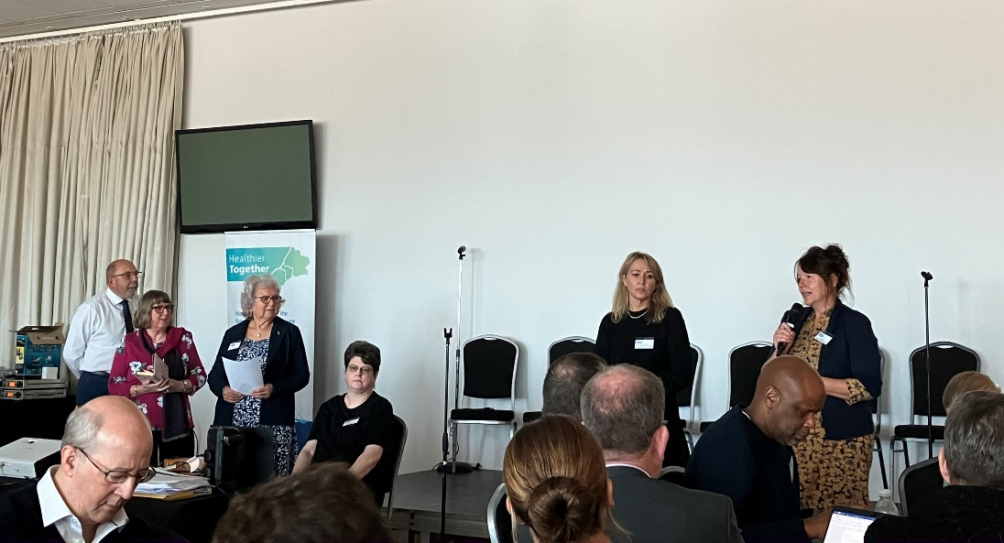
Working differently:
Weston, Worle & Villages Locality
One Weston, Worle and Villages Locality Partnership shared with us their experiences of how all partners have come together over the last 12 months to design a new model for an Integrated Community Mental Health team. We heard a real example of how wrapping a team around the person had helped them to manage other areas in their life, as well as accessing support when needed.
Two contributors with lived experience shared with us the positive aspects of being involved in designing the new team and service, and the hopes they have for improved support for people in the future. We also heard from voluntary and community sector colleagues, who explained the key role the sector can play and examples of how the partners worked effectively together.

Slide 19
Session 2: Experiences of good partnership working
Reflecting on experiences of good partnership working, participants identified the following key values and behaviours. These will inform a shared BNSSG approach to guide strategy delivery:
Always come back to the person / people we are trying to help.
Clarity of focus (the pandemic response was highlighted across tables) and agreed outcomes with clear call to action.
One or two areas of shared focus, rather than lots of different things.
The need not only to include community organisations but empower them.
Mutual trust and respect.
Delegated leadership.
A “problem solving” culture.
A sense of urgency (vs. the primacy of governance and bureaucracy) with permission to “get on with it”.
Understanding each other’s goals, challenges and perspectives. Requires listening!
Clear responsibilities and people held to account.
Agreed principles for working that are revisited and used, include “disagreeing well”.
No egos in the room, less hierarchies and status. “More human”.
User / lived experience voice and representation, fully involved.
Common understanding of risk appetite.
Common language.
Willingness and openness to collaborate.
Building relationships and spending time together.

Slide 20
Session 2: What success will look and feel like
The following criteria were identified for success:
Clarity on the problem we are collectively trying to solve.
Strength and asset-based partnership – aligned priorities, understanding what each partner can bring.
Sustainable funding, devolved budgets and support. Long term investment in relationships.
Greater participation of people with lived experience and VCSEs; place-based and broader partnerships working with communities and VCSEs. Those with lived experience seen as equal partners.
A clear “single picture” of a person that is consistently used by all organisations – “tell their story once”. Patients at the centre of decision making.
Employers having wellbeing policies in place.
Being bold and prepared to make mistakes, freedom to take risk. Challenging each other with respect.
Permission to fail and psychological safety, the ability to learn from when things go wrong.
Common language and standards.
Collaboration – we need to “stop the blame game”.
Risk sharing across the partnership.
Primary Care needs to be reinvigorated.
Believing and feeling the partnership – “I work in the BNSSG partnership“

Slide 21
Session 2: Voices from the room
What are your experiences
of good partnership working?
What will success look
and feel like?
“The test of partnership working is when things aren’t going well”
“All partners and staff feel like equal partners and feel confident to participate”
“Creation of an entity that people want to be a part of”
“Trust begets trust – assume positive intent”
“No-one had all the answers and we were honest about it”
“Stopped having to explain why the VCSE sector is not free”
“What are we each going to give, get, give up and get over?”
“Having shared ‘hats’, rather than organisations pushing individual agendas: ‘lanyard agnostic’”
“Finger pointing gets us nowhere, but we must have accountability and learn how to disagree”

Slide 22
Session 2: Feedback
“how are we going to change and really integrate dialogue, needs, feedback, experimentation and understanding outcomes and change?”
How would you rate the content, discussions and activities during Session 2: Working together as a partnership
(n = 33)
“Highlighted the lack of working across partnerships”
“Content excellent”
Based on survey responses as of 31/10/2022

Slide 23
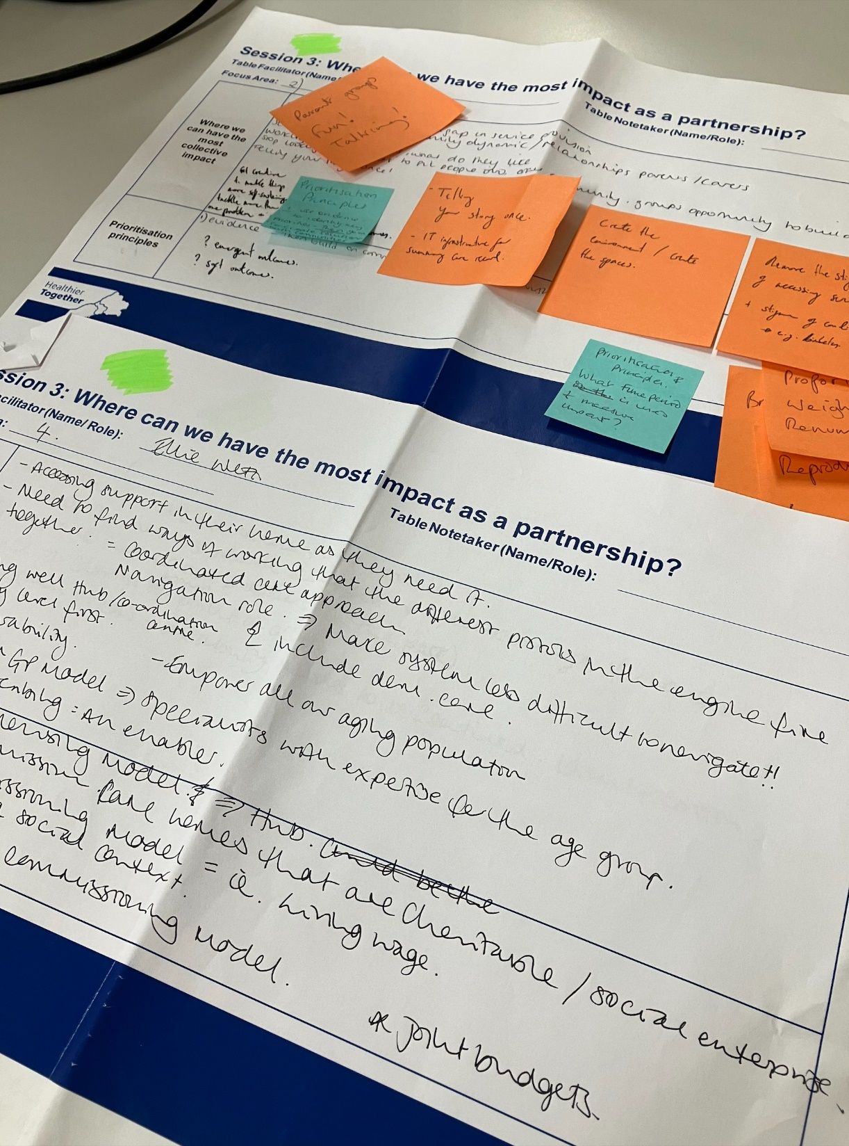
Session 3
Focussing our strategy
Participants had an early opportunity to reflect and feedback on some of the emerging focus areas.
Each table was asked to select two focus areas to discuss, with a view to identifying opportunities for impact in each by working together as a partnership.
For each focus area, participants were asked:
Where can we have the most impact in this area by working differently as a partnership?​
How might the prioritisation principles support this?

Slide 24
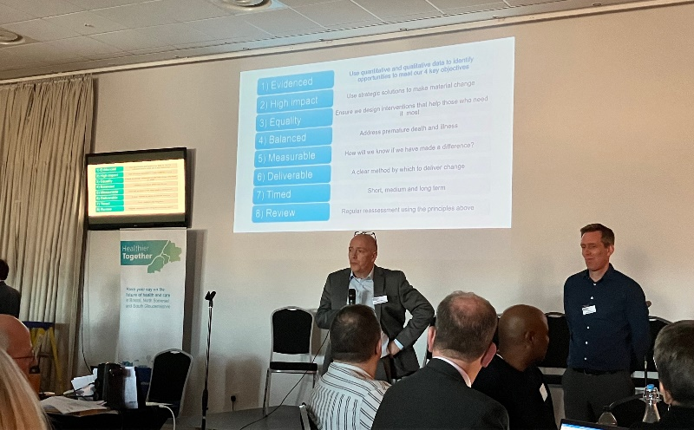
Focussing our strategy
Colin Bradbury (Director of Strategy, Partnerships & Population for BNSSG ICB) and Matt Lenny (Director of Public Health & Regulatory Services at North Somerset Council) talked through the need for clear principles to inform shared, strategic decision-making.
The risks if the strategy does not recognise the need to fundamentally change the way the health and care system functions were highlighted by the fate of Blockbuster, as an analogy of what happens when the need for a different model of working, in response to a changing environment, is not recognised or acted upon.
“BNSSG Version 1.1778”
“BNSSG Version 2.0?”
OR
Notes:
Use PH data to guide where to focus resource – focus on outcomes
get on and do things - test and learn
Stop prioritising the 'need' or condition we think is important. Prioritise those who are most in need
Supportive - 1,2,3 and 7 (long-term). Not necessarily - 4. Bit difficult! - 5 don’t like measurement and what we're looking at and the 'right things to do'

Slide 25
Session 3: Areas of potential focus
Participants were provided with an early opportunity to reflect on emerging and draft focus areas for the BNSSG integrated care strategy:
Poverty and Discrimination
Includes people who:
Do not have access to the building blocks of good health and wellbeing
Children and Young People
Includes people who:
Are excluded from school, in the care system or have experienced Adverse Childhood Experiences
Mental Health and Wellbeing
Includes people who:
Live with serious mental illness or learning disabilities, as well as those with less severe or fluctuating conditions
May smoke, or do not have a healthy weight, are malnourished
Are living with or at risk of diabetes, hypertension, stroke and cancer
Use drugs and alcohol to a point that they cannot control
Have experienced trauma.
Are living with anxiety or depression during childhood
Do not have a healthy weight
Have poor physical health related to their mental health
Experience trauma
Use drugs and/or alcohol to a point they cannot control
Living with multiple conditions that they struggle to manage
Proactively supporting those most in need
Includes people who:
Frequently have crises and require urgent and emergency care
Are living with, or at risk of, dementia
Are at risk of falling
Are living with multiple conditions that they struggle to manage
Isolation and Alienation
Includes people who:
Are experiencing loneliness
Are out of work due to their health
Do not feel part of a community
Struggle to get to the services they need
Identify as lesbian, gay, bi, trans, queer, questioning or ace (LGBTQ+)
Are within groups often excluded e.g. people experiencing homelessness, gypsies and travellers, vulnerable migrants and sex workers

Slide 26
Session 3: The importance of prioritisation
Participants were provided with suggestions as to how we might prioritise activity and focus within these:

Slide 27
Session 3 – Areas for collective impact (1/3)
Areas highlighted where we could have the most impact by working differently as a partnership:
Poverty and discrimination | Smoking is a known, poverty-aligned risk factor and we have a clear evidence base. Access to social prescribing and talking therapies for all ages - especially children and young people. Multidisciplinary approach to address adverse childhood experiences (ACEs) and improve outcomes for several generations. Secure housing and the impact of healthy homes via a place-based and locality approach. Screening in communities with lessons from the vaccination programme around access and outreach. Childhood immunisation applying the lessons from Covid. Part-time community workers, peer support and peer workers, utilising the pandemic infrastructure. Community empowerment and asset-based community development to narrow down the focus to what communities actually need. Population health management infrastructure sharing datasets to build better picture of population, pockets of deprivation and discrimination. Will really help us target interventions. Our workforce and our role as employers - are we representative? Where is the lived experience?

Slide 28
Session 3 – Areas for collective impact (2/3)
Areas highlighted where we could have the most impact by working differently as a partnership:
Children & Young People | A whole-family approach. Data sharing: could we have one system, e.g. Think Family database School exclusion: what services to we need to have alongside schools? School meals: supporting nutrition and healthy eating. Focussing on childhood obesity. Wellbeing practitioners in secondary schools (currently being rolled out). School nurses are great and could drive more of these wellbeing initiatives, Holistic support around families bringing care and support closer to families in their communities e.g. antenatal, sure start, family hubs. Universal early intervention support for the first 100 days, first 1000 days. “Sure start everywhere!” Building a collaborative social prescribing service focussed on children and young people. Providing a community-based 'wellbeing' programme of activities for children and young people. Improving mental health support.

Slide 29
Session 3 – Areas for collective impact (3/3)
Areas highlighted where we could have the most impact by working differently as a partnership:
Mental Health and Wellbeing | Early intervention ensuring that all workforces are trained in trauma-informed approaches. Working with schools to develop health and wellbeing programmes.
Proactively supporting those most in need | Ensuring we have a good frailty offer and that this is more community-based. Consider the Admiral Nursing model (specialists that work with families affected by dementia and provide support to health and social care colleagues to improve the dementia care). Inequalities as a clinical criteria for prioritisation including learning difficulties, looked after children, deprivation and poverty. Advanced care planning involving all partners and VCSEs. Dementia and falls – building dementia friendly houses, all housing should have a dementia impact assessment. Train resources to ensure houses are dementia and falls-friendly. Ageing well hubs / coordination centres which put the community level first and harness social prescribing as a key enabler of our broader goals.

Slide 30
Session 3: Overall feedback on emerging focus areas
People experiencing poverty and discrimination, particularly where it negatively impacts their health and wellbeing
Children and young people who do not have the best start in life
Mental health and wellbeing
Proactively supporting those most in need
Breaking the cycle for people experiencing isolation and alienation
There is a potential overlap between the areas – this was especially highlighted between ‘Poverty and Discrimination’ and ‘Proactively supporting those most in need’.
The emerging focus areas feel too big currently. There was a perceived risk of lack of clarity and a feeling the wording of each area would need re-phrasing to ensure that they are sufficiently distinct.
Care for elderly people and people with disabilities needs more emphasis – right now, age and frailty are not sufficiently highlighted.
No group selected “Breaking the cycle for people experiencing isolation and alienation”. This does not indicate that groups did not think this area was important, as many related points were highlighted under other themes.

Slide 31
“I felt that the potential focus area regarding those 'most in need’ completely missed the point of a partnership… essentially, how can we define anyone as most in need when the services on offer from different parts of the ICP are so varied, and as such there can't be
a single most in need group.”
Session 3 – Feedback
How would you rate the content, discussions and activities during Session 3: Focussing our strategy
(n = 33)
“I think there was a real challenge …as the areas that were highlighted were somewhat ambiguous in the way that they all related to each other”
Based on survey responses as of 31/10/2022

Slide 32
Panel Discussion and Q&A

Slide 33
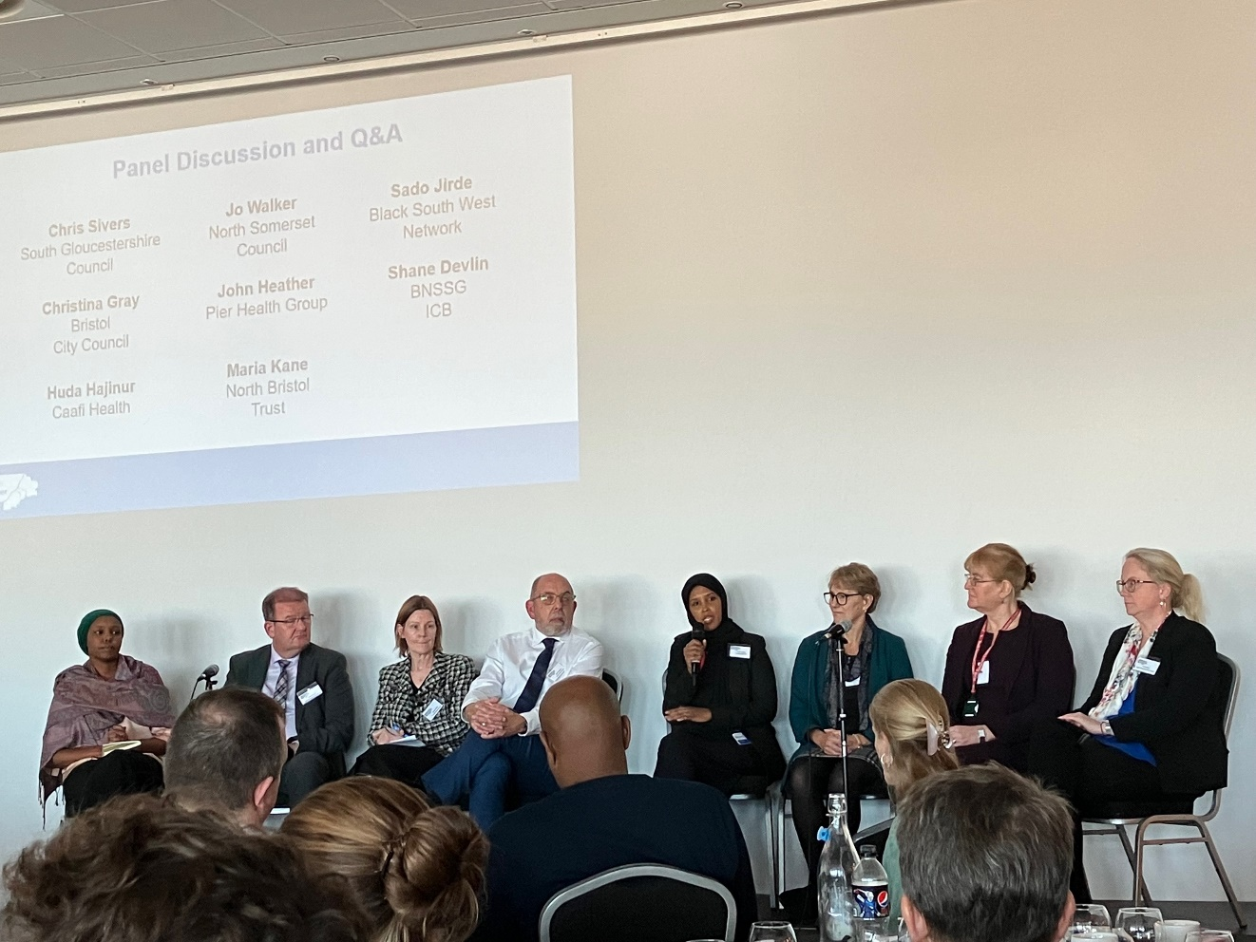
Panel Discussion
and Q&A
Participants were able to submit and vote on questions for the afternoon’s panel through the day.
The panel was an opportunity to reflect on and build on the day’s “collective conversation”, covering a diverse range of topic areas.
The panel included:
Chris Sivers (South Gloucestershire Council)
Christina Gray (Bristol City Council)
Huda Hajinur (Caafi Health)
Jo Walker (North Somerset Council)
John Heather (Pier Health Group)
Maria Kane (North Bristol Trust)
Sado Jirde (Black South West Network)
Shane Devlin (BNSSG ICB)

Slide 34
Q&A Summary
Questions were taken both from the “Menti” app and from the floor. These have been grouped into themes along with reflections from the panel.
Theme | Questions | Panel reflections
Impact | Reflecting on the day, what have you heard that has made the biggest impression on you? | The focus on Children & Young People. The strategic needs data and how it was presented. “Didn’t think we’d be talking about housing today” which has given me hope Misunderstanding of communities, they need to be seen as a diverse part of the solution, not just a homogenous group to involve. Trying to stop thinking like a clinician (but it's difficult). “I’m not sure if people understood the data that was presented this morning, if they did we would be talking more about the need to do things fundamentally differently” Devil is in the detail of the strategy, the what. That’s where the richest conversation was. Needs to be an equal power relationship with communities Discussions on our table about how brave do we want to be. Use health inequities as a criteria for access as an example.
Risks and resources | Do we have the money and levers to make the shift to prevention / social / wellbeing/ community aspects? Shane's response suggested that we will need to refocus resource upstream - this means less resource to hospitals, how do we think this will play out politically? What’s our approach to risk? Every organisation and sector is different. | We have already moved things around and made progress on this. The money is there, it’s about our clarity of purpose We need a common framework and agreed approach to risk as a system.

Slide 35
Questions were taken both from the “Menti” app and from the floor. These have been grouped into themes along with reflections from the panel.
Theme | Questions | Panel reflections
Prioritisation | Are we brave enough to stop doing things we’re doing to create the space for collaboration and partnership working? We have to agree a common cause and purpose and shared ownership to deliver. What do we STOP doing/investing in? The 5 focus areas are helpful to help us focus on impact but mean saying no / reducing focus on some areas that we will be challenged on as an ICS and individual providers - will we all agree to try? Given today’s HSJ headline about the public not supporting prioritisation of patients based on reducing inequalities - how can we take the public with us? | It was acknowledged that we will need to stop things and haven’t been as good at this in the past. This will require difficult decisions and need for bravery. It will also require transparency. If something isn’t a “priority”, it doesn’t mean nothing is being done. We will still provide services and support. We need to get the most “bang for our buck” as a collective system and be smart about where we target.
Prevention | Why is the health system designed around treating illness rather than keeping well? Linked to so many of these questions. How do we genuinely shift the dial from focussing on treatment to focussing on prevention? How can we positively influence inequalities in long term health whilst managing today crisis at the same time? What are the actions to achieve this? Smoking is not the cause of smoking, ditto high blood sugar, substance misuse etc. The cessation programmes can be good but why not invest in the real causes upstream? How far are we willing to go to do the "right thing" i.e. pool resources to focus on prevention over a longer timeframe when the national context makes it a lot harder to do so? | There is a need to move away from “NHS mindset”, but there are also a number of “burning platforms”. Our system was built on the demand for hospitals and social care. This can lead to a reactive response. We need to look at the conditions to create health and wellbeing. Prevention is generally too broad and crude a term We can explore pooled budgets but this is also about aligning our resources and how we work.

Slide 36
Additional questions which it was not possible to cover on the day were also captured and are shared below:
Theme | Additional questions
Communities and VCSEs | What are the top three messages that the panel would like the VCSE sector to hear about enabling community organisations to participate in tacking the strategic themes? Can we look at solutions, simple and quick actions / changes that can be implemented and would contribute to gaining trust from communities? The wider involvement of the VCSE needs sustainable long-term funding to create stable, flexible foundation. So much of NHS funding is short term, in year and often non-recurring. How can this change? How do the panel feel about better investment (and where from) into the Social Prescribing model, partners and organisations with the Community supporting taking the pressure off services already overstretched. Family carers will support our joint ambitions - how will we hear their voice and should we have ambitions specifically focussed on carers
Leadership | ICP leadership. We need courageous compassionate leadership. When you look back in 10 years what will you be proud of doing because it really made a difference to the population most in need? At a practitioner level, there is a real commitment to collaborative working across organisational boundaries - what steps are the leaders of organisations in BNSSG taking to enable this? How can power be redistributed so we can share and build power together? When do we start questioning the status quo and look at what other countries do?
Other partners | There is a real issue with dentists. What is being done about this? Is the private sector included in our conversation? Should they be?
Social isolation | Given the impact of social isolation on mental health and general wellbeing, should it be on our list of preventative opportunities to focus on? Isolation is as harmful to health as smoking 15 cigarettes a day. What impact will the never-seen-before social isolation of young people in 2020-21 result in? How can we protect against negative long-term impacts?
Workforce | Surprisingly the challenges around human resources in health, care, children & adult services have not been highlighted. Particularly the social provisions & culture for staff (not just blaming on pay).
Next steps | So, what next? How are we taking the inputs from today forward to make a positive and measurable difference to our communities? How do we start to move from the way we do things now to different pathways - cliffs edge, just do it and learn or incremental?

Slide 37
“it was great to have a panel which included leaders from the statutory partners and the VCSE story”
“I like the process of using Menti and voting on questions.”
Panel Q&A– Feedback
How would you rate the panel Q&A?
(n = 33)
“Really appreciated how it was set up with questions that could be rated before - felt like we didn't need to let everyone answer every question”
“It brought out the same challenges and also the hope but not the how. If NHS conceived to fix illness and now needs re-purposing to maximise wellbeing, then users' expectations may need to change also??”
“More time for more discussion would have been good - big panel meant it was hard to get everyone’s opinion, maybe smaller panel next time”
Based on survey responses as of 31/10/2022

Slide 38
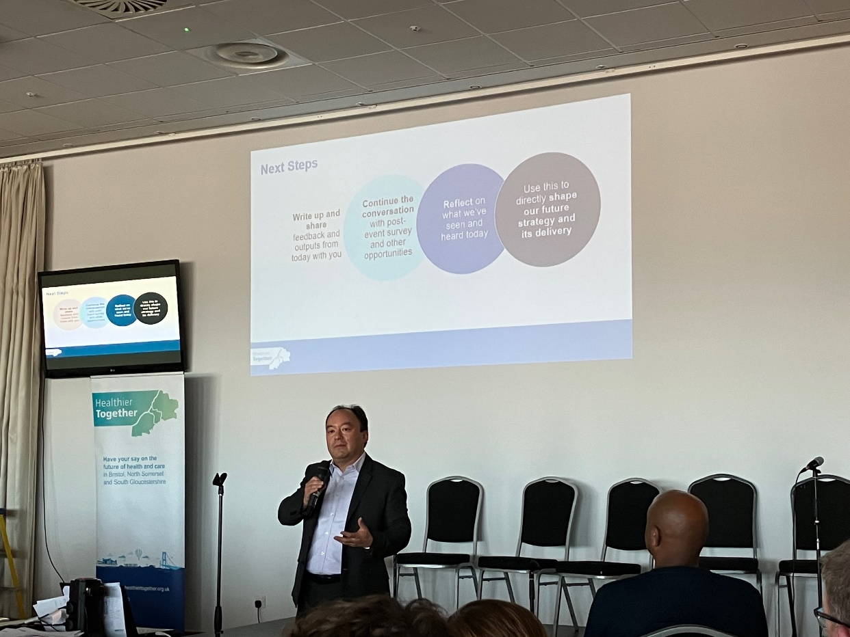
Key next steps
This event write up is being shared with all attendees.
The Integrated Care Partnership Board will meet in public on 16th December 2022 to approve a draft of the system strategy.
Attendees of the Partnership Day will be invited to comment on the draft strategy. All other feedback is very welcome and channels will be available to support wider engagement.
A final draft strategy will be agreed with members of the Integrated Care Partnership and published by the end of March 2023.

