Slide 1
BNSSG Primary Care Strategy
Update July 2019

Slide 2
What is Primary Care?
GP
SURGERIES
COMMUNITY PHARMACY
DENTAL
OPTOMETRY
Our patients are at the core of a proactive community system
General Practice has a leadership role to create a system of care in the community equitable and accessible to all
Primary Care is the alliance of all providers in the community, including community services, community pharmacy, dentistry and the voluntary sector

Slide 3
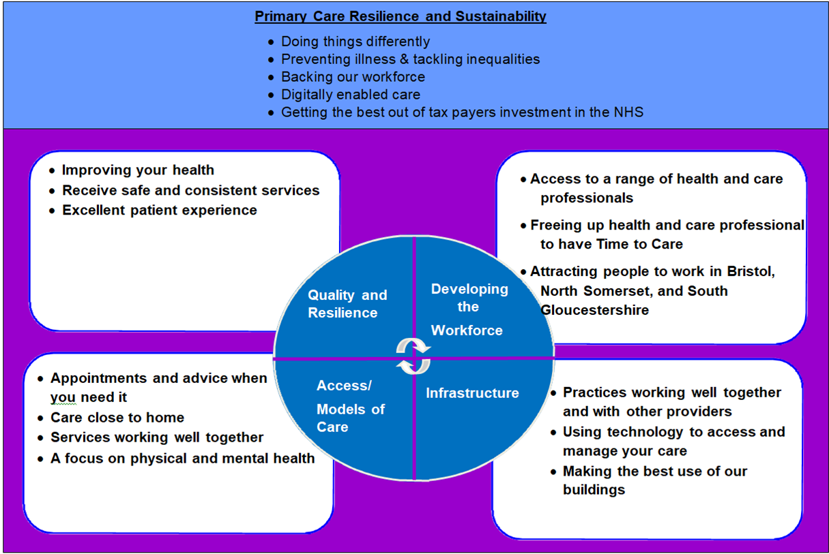
Our Priorities

Slide 4
Key Engagement Questions
What are our priorities for developing Primary Care in BNSSG?
What does good look like?
How will Primary Care Networks (Primary Care Networks are groups of practices working together with other providers of health and care in your community) support the needs of our population?
How will we deliver our priorities?

Slide 5
Current vision
‘A resilient and thriving primary care service of which is at the heart of an integrated health and social care system centred around the patient and carer;
A responsive system that delivers needs-based high quality, equitable and safe care.’

Slide 6
Launch Event Workshop Outputs: The Vision

Slide 7
Vote on the Vision Statement
Better conversations about me and my care
Delivering excellent, high quality, accessible care for you in a sustainable, joined up way
A strong, accessible, responsive, sustainable, high quality primary care system that improves health outcomes for all
We are proud to deliver personalised, seamless, consistent, high quality primary care that is accessible and sustainable for all
13

Slide 8
How can you get in touch?
“Get Involved” section of CCG website
Further practice managers, GPs, nurse, patients and public involvement
Surveys and consultations | NHS Bristol, North Somerset and South Gloucestershire CCG
https://bnssgccg.nhs.uk/get-involved/surveys-and-consultations/
17

Slide 9
Get Involved
https://bnssgccg.nhs.uk
19

Slide 10
@HTBNSSG

