Slide 1
A year of the Healthier Together Panel: key learnings, implications and next steps
Prepared by: Alex Ward-Booth & Ben Carlson-Davies, Insights and Engagement, Bristol, North Somerset and South Gloucestershire CCG

Slide 2
Introduction to the Citizens’ Panel

Slide 3
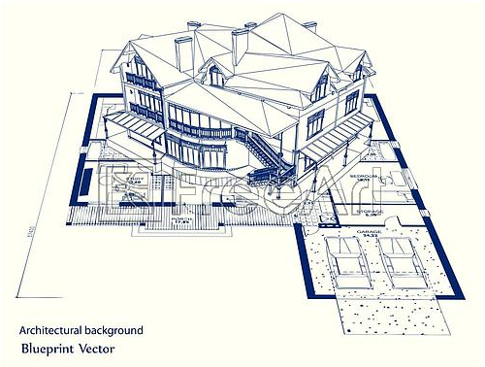
Where are we now?
Multiple Options
Beyond Basecamp
Develop a Blueprint

Slide 4
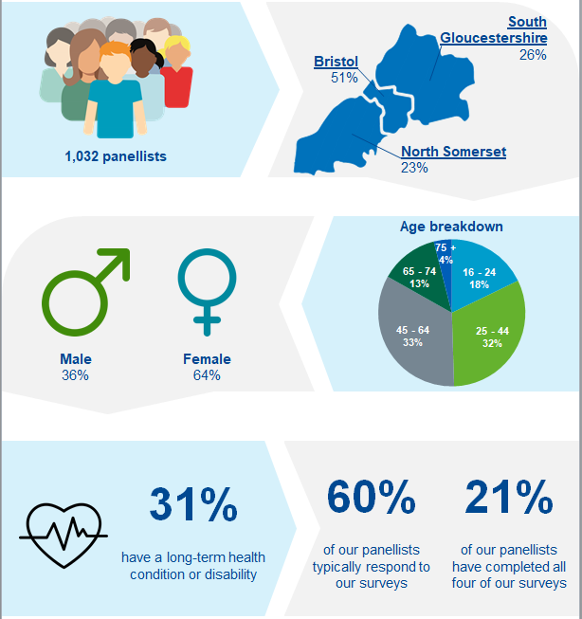
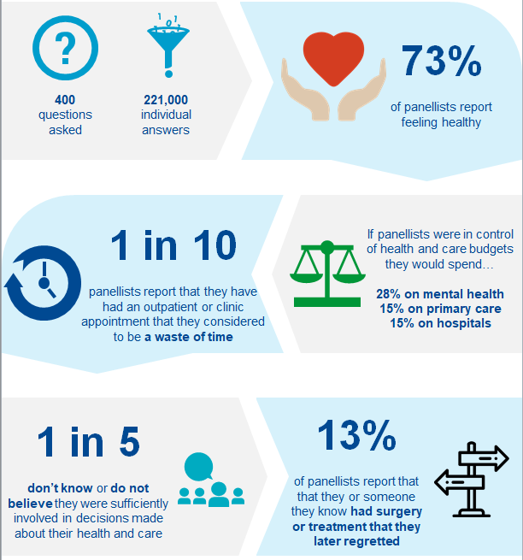
Overview of Healthier Together panel
Who are our panellists?
Key insights from our panellists

Slide 5
Survey 4 results: Key learnings and insights from our most recent survey

Slide 6
Overview of topics covered in Survey 4
Planned care and changing the way we communicate before and after appointments
Integrated care, focusing on joined-up care and GP practices working at scale
Medication adherence and medication reviews

Slide 7
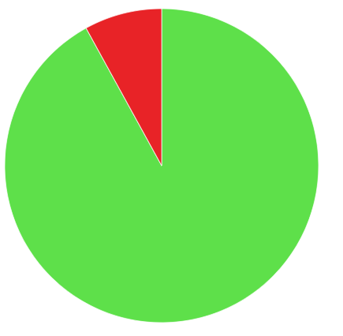
Planned care
People who are unemployed, unpaid carers or lone parents are more likely to report having missed a hospital appointment
Proportion of people who have missed a hospital appointment
Base = 413, all those who have ever had a hospital appointment
Those more likely to have missed a hospital appointment on the day:
Unemployed 32%
Unpaid carers 21%
Lone parents 19%
Inner City and East 18%
25-44 years 11%
Yes, I have missed a hospital appointment on the day
8%
I have never missed a hospital appointment on the day
92%
13% of participants had never had a hospital appointment (n=60)

Slide 8
Planned care
Almost two-thirds of people are in favour of changing the way we interact with people prior to appointments by utilising pre-health assessment forms via email or text
Extent to which people are for or against completing a health assessment via email or text prior to appointments:
Base n=473
Against
4%
Moderately
against
12%
75+’s 15%
Neither/nor
21%
Moderately
in favour
32%
S Glos 12%
Inner City & E 17%
N & W Bristol 28%
16-24’s 37%
Strongly
in favour
31%
Not appropriate or accessible for all
Saves time in the appointment
Prefer to discuss information (especially sensitive information) in person
Helps make the appointment more focused
Perceived as another tick-box exercise
Helps patients to prepare and reflect on appointment
Not clear how HCPs will have time to review and use information

Slide 9
Integrated care
Due to a positive experience of referrals or quality of care most people perceived health and care services to be well joined-up, however one quarter had a more mixed or negative experience
Extent people perceive multiple health and care services to be well organised and joined up: Base n=244
64% of participants report that care was well organised and joined up
26% of participants report that care was not well organised and not joined up
Referral process was good (quick, easy and efficient)
Referral to treatment - waiting
time too long
Sharing of information is poor,
flow of information
Exceptional quality of care
Lack of communication between healthcare professionals
Resources - lack of staff,
under pressure

Slide 10
Integrated care
Most people are in favour of local GP practices working at a greater scale, but concerns about travel times, distance and lack of continuity will need to be addressed for some
Against
11%
Moderate 9%
Strongly 2%
Extent to which people are for or against GP practices working at scale (e.g. different practices in an area providing specialist services and expertise): Base n=473
Moderately
in favour
46%
Neither/nor
14%
Worle, Weston 21%
Long standing conditions 16%
75+ years 14%
Unemployed 14%
Strongly
in favour
29%
Concern over travel distance and time
N & W Bristol 65%
Woodspring 57%
Those living alone 59%
Students 57%
Inner City & E 42%
S Glos 37%
BAME 46%
Lose of continuity of care / relationship with current GP
Improves access to expert and specialist care
Confusing and difficult to navigate for some
May lead to better treatment and outcomes
Better use of resources

Slide 11
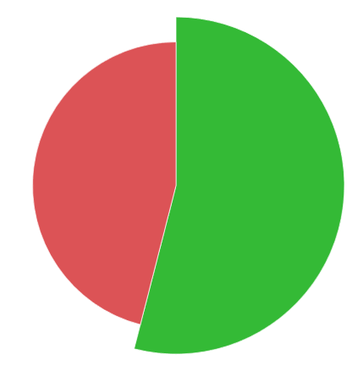
Medications
Just under half of people report taking prescribed medications, with those people taking an average of two - three different medications
Proportion of people who report taking prescribed medications on a regular basis Base n=473
Those taking:
S Glos 62%
Worle/ Weston 56%
Inner City & East 56%
Woodspring 44%
South Bristol 40%
N & W Bristol 23%
16-24 yrs 21%
25-64 yrs 43%
65-74 yrs 72%
75+ yrs 80%
Long standing conds 79%
Taking regular prescribed medicines/ tablets
46%
Not taking any regular prescribed medicines/tablets
54%
Those taking, take just under 3 different medicines/tablets each on average
1 medicine/tablet 42%
2 medicines/tablets 30%
3-5 20%
6-10 7%
11+ 1%
NB: 2016 piece of work from NHS Digital found 48% of adults had taken a prescribed medicine in the last week. Using EMIS the percentage is 45.2% across BNSSG

Slide 12
Medications
Almost one third of people report that they occasionally or regularly do not take their prescribed medications as directed by healthcare professionals
Self-reported frequency of taking prescription medications as directed by HCPs Base n=219
27% of participants report ‘occasional’ non-adherence
5% of participants report ‘regular’ non-adherence
Almost 100% of the time
68%
80%-90%
of the time
17%
50%-80%
of the time
10%
Under 50%
of the time
5%
S Glos 17%
Worle,WV 14%
16-24 yrs 52%
BAME 34%
Living alone 21%
Inner City & East 40%
BAME 42%
Not working 27%
25-44 yrs 14%

Slide 13
A year in review: key insights and learnings about our citizens

Slide 14
What have we learned about our citizens so far?
1
Significant inequalities exist in perceptions of health, happiness and control
2
People do not always see the value of appointments or treatments
3
Most people are looking for more involvement in their healthcare decisions
4
5
We see openness to digital health across most of the population, but there are important considerations for some groups
They are open to new ways of delivering healthcare

Slide 15
Significant inequalities exist in perceptions of health, happiness and control
Compared statistically to other comparison groups, in residents of BNNSG are less likely to report feeling healthy, happy or in control if…
You live in Weston, Worle & villages, South Bristol or Inner City and East
You are not currently working (excluding people who are retired)
You have a long-standing health condition or disability
You are currently living alone

Slide 16
People do not always see the value of appointments or treatments
Lack of shared decision making
Lack of informed decision making
Waste of time appointments
Surgery or treatment later regretted
20% don’t know or do not believe they were sufficiently involved in decisions
15% report not being given opportunity to discuss risks and benefits before a procedure or treatment
11% report having had an outpatient appointment that they considered to be a waste of time
13% report that that they or someone they know had surgery or treatment that they regretted
People who are not working, live in WWV, have a long-term condition or aged 25-44 years are more likely to report not being involved in decisions
People with long-term conditions, live in Woodspring or aged 25 – 44 years are more likely to report lack of informed decision making
This opinion was spread evenly across sub-groups but significantly lower in WWV locality, older individuals and lone parents
People who live in ICE, living with long-term conditions and those aged 75+ over were more likely to report regretting surgery or treatment

Slide 17
Most people are looking for more involvement in their healthcare decisions
81%
of people are very confident or quite confident in their ability to reach a shared decision about their care and treatment with a healthcare professional
62%
of people believe it is mainly an individuals responsibility to ensure they are healthy and well, with another 23% believing it is an equal responsibility between NHS/LA and individuals
28%
If people were in control of health and care budgets they indicated they would spend 28% on adult and children’s mental health, with a further 30% split between primary care and acutes

Slide 18
They are open to new ways of delivering healthcare, including via online and digital platforms
A majority (89%) of BNSSG residents are in favour of alternative / additional solutions, such as social prescribing, to prescription drugs
Assuming they knew more information, 80% of BNSSG residents would consider going to a Pharmacy rather than a GP if they are unwell
A majority (75%) are in favour of local GP practices working at greater scale, with specific practices providing specialist services or expertise for specific conditions
A majority (81%) of BNSSG residents are comfortable with their health and social care records being shared with other NHS professionals
A majority (70%) are also comfortable with telephone consultations, booking their appointment online and/or receiving a test results by email
However 83% of BNSSG residents would still prefer to see someone face to face rather than more quickly via an online consultation

Slide 19
Activity: What, So What, Now What?
What
What facts or observations stood out?
So What
Why is this important?
What hypotheses can you make?
Now What
What is the main learning?
What else do we need to know?
What patterns or trends are emerging?
What actions make sense?

Slide 20
Wrap up and next steps for the Citizens’ Panel
Survey 5 is currently in development, if you have a question or topic you would like to see included in the survey please get in touch with Ben or Alex
Over the next 6 months, we are planning to increase the size of the panel to 1,500 people, focusing our efforts on specific groups or communities who are currently under-represented
We are also exploring new and innovative methods of working with the panellists, including more qualitative or exploratory research with specific groups

Slide 21
Key learnings and plans for next year

Slide 22
Translating our key learnings from 18/19 into an action plan for 20/21
Strengths
Opportunities
Aspirations
Results
What can we build on?
Highly engaged and responsive panel, which is broadly representative of our population
Complements population health management; providing data and insights into various groups, segments and localities
Demonstrated value to numerous programme teams, establishing strong foundation for stakeholder engagement
Insights have effectively confirmed or dismissed internal hypotheses
What can we do better?
Increase panel size to increase our base size for each survey, targeting key demographic groups and areas to ensure representation
Improve the strategic planning of survey themes and content
Refine the questionnaire development process and follow-up process
Enhance outputs, insight management and knowledge mobilization
What do we aspire to be
able to do?
Drive system-wide engagement, including acute hospitals, providers and local authority
Build closer collaboration with population health management, moving towards the development of more interactive reporting tools
Utilise approaches and methodologies that complement panel and can continue to bring the voice of our citizens to life
Capture comparative insights from health and care staff
What can we measure to ensure we deliver value?
Support insight-led planning or strategy in four priority programmes
Deliver three – four qualitative, deliberative workshops on key themes and content
Demonstrate improved engagement and satisfaction of internal stakeholders across the system

Slide 23
Any questions?
Alex Ward-Booth, Head of Insights and Engagement, BNSSG CCG - alex.ward-booth1@nhs.net
Ben Carlson-Davies, Insights and Engagement Manager, BNSSG CCG – ben.carlson-davies@nhs.net
Justin Warr, Interim Comms and Engagement Manager, Healthier Together – justin.warr@nhs.net

Slide 24
Contact us:
Healthier Together Office, Level 4, South Plaza, Marlborough Street, Bristol, BS1 3NX
0117 900 2583
Bnssg.healthier.together@nhs.net
www.bnssghealthiertogether.org.uk

