Slide 1
Shaping the BNSSG Primary Care Strategy Workshop
June 18th 2019

Slide 2
Welcome
Transforming Primary Care through System Wide working in BNSSG
Ruth Taylor
Chief Executive, OneCare
Healthier Together, General Practice Resilience and Transformation, Chair.

Slide 3
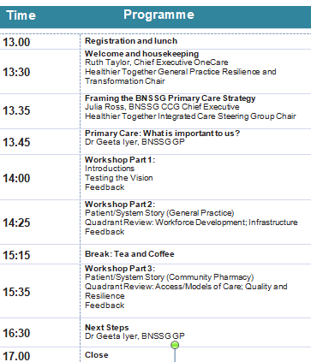
Objectives
To collectively develop and co-produce the vision.
To understand and confirm our priorities.
To describe what success looks like.
To look at how Primary Care Networks will support the needs of our population.
To agree how will we deliver our priorities.

Slide 4
Framing the BNSSG Primary Care Strategy – meeting the needs of people and our population.
Transforming Primary Care through System Wide working in BNSSG
Julia Ross
Chief Executive, BNSSG CCG
Healthier Together, Integrated Care Steering Group, Chair.

Slide 5
Primary Care is at the Heart of the Community
Our patients – the registered list - is at the core of a proactive community system
General Practice has a leadership role to create a system of care in the community
Primary Care is a vital partner in the Alliance of all providers in the community, including community pharmacy, dentistry and the voluntary sector

Slide 6
Primary Care Networks form the
building block for integrated care
Long term plan | Function
Integrated Care System (ICS) | Strategic
Integrated Care Partnerships (ICP) Provider Alliance | Planning and coordination across providers
Primary Care Networks | Practices working together Resilience Local Delivery Shared Resource
STP
Locality
Primary Care Network

Slide 7
Our Principles
Establishing the community as the default setting for all of a person’s care
We will make a significant shift to a proactive model of care
We will deliver a reliable and consistently available 24/7, service that is coordinated and effective
All partners, will be focussed on the needs of the population, sharing collective resources and with a common purpose
We will take an asset approach: valuing the capacity, skills, knowledge, connections and potential in individuals and communities
Mobilising the community
Building an alliance amongst all ‘providers’ in the community to join up around individuals and families

Slide 8
Our Vision for a Model of Care in the Community
GP Provider Localities
Collaboration across practices/PCNs
Leading and directing community services
Leading locality hubs
Leading locality Provider Alliance
Specialist advice and support
Small number of highly trained specialists
Educational input to core community services and primary care
Advice and care for complex cases
Linked to acute speciality teams
Practices
Inner City & East Bristol Integrated Locality Team
Acute and Reactive Care
Integrated across hubs & localities
24/7 rapid response
In-hospital liaison and pro-active discharge support
Specialised in catheter care & complexity
Access to community beds and IV therapies
Practices
Practices
South Bristol Integrated Locality Team
North & West Bristol Integrated Locality Team
PEOPLE &
FAMILY
Weston &
Worle
Integrated Locality
Team
S. Glos
Integrated Locality Team
Practices
Woodspring Integrated Locality Team
Practices
Locality Hubs
Frailty management
Focus on proactive care
7 day primary care
Ambulatory Care
Treatment rooms
Access to diagnostics
Practices
Integrated Locality Teams
Working across primary care, community and hubs through regular multidisciplinary team meetings
Includes district nursing, community therapies, dietetics, podiatry and orthotics, voluntary sector, speech and language, domiciliary phlebotomy, urinalysis and blood pressure

Slide 9
Primary Care: My Clinical Perspective
Transforming Primary Care through System Wide working in BNSSG
Geeta Iyer
BNSSG GP

Slide 10
Outputs for the Day
To collectively develop and co-produce the vision.
To understand and confirm our priorities.
To describe what success looks like.
To look at how Primary Care Networks will support the needs of our population.
To agree how will we deliver our priorities.

Slide 11
Workshop Etiquette
Please nominate a spokesperson for your table for Workshop 2 and 3.
No right or wrong answers
Say what’s on your mind
Don’t be afraid to disagree – but respect other views
Don’t necessarily wait for questions from the facilitator
Try not to speak over each other
Try to give everyone air-time

Slide 12
Workshop 1: The Vision
An opportunity to reword our vision so that it is more compelling
Thinking about your hopes and ambitions for primary care.
What 3 words would be the words you would use to describe primary care in 5 years time?
15 minutes to discuss

Slide 13
Our Proposed Priorities
Quality and Resilience
Developing the Workforce
Access to a range of health and care professionals
Infrastructure
Access/ Models of Care
Appointments and advice when you need it
Improving your health
Practices working well together and with other providers
Receive safe and consistent services
Excellent patient experience
Freeing up health and care professionals to have Time to Care
Attracting people to work in Bristol, North Somerset, and South Gloucestershire
Care close to home
Services working well together
A focus on physical and mental health
Using technology to access and manage your care
Making the best use of our buildings

Slide 14
Workshop 2:
Workforce Development and Infrastructure
In your tables, thinking about Workforce Development and Infrastructure:
What are our priorities for developing Primary Care in BNSSG?
What does good look like?
How will Primary Care Networks support the needs of our population?
How will we deliver our priorities?
30 minutes to discuss and write feedback on the template provided
15 minutes feedback

Slide 15
Workshop 3:
Access/Models of Care and Quality and Resilience
In your tables, thinking about Access/Models of Care and Quality and Resilience:
What are our priorities for developing Primary Care in BNSSG?
What does good look like?
How will Primary Care Networks support the needs of our population?
How will we deliver our priorities?
30 minutes to discuss and write feedback on the template provided
15 minutes feedback

Slide 16
Next Steps
Transforming Primary Care through System Wide working in BNSSG
Geeta Iyer
BNSSG GP

Slide 17

Outputs from Workshop 1:
The Vision

Slide 18
Thank you – please keep in touch……..
Surveys and consultations | NHS Bristol, North Somerset and South Gloucestershire CCG
https://bnssgccg.nhs.uk/get-involved/surveys-and-consultations/

Slide 19
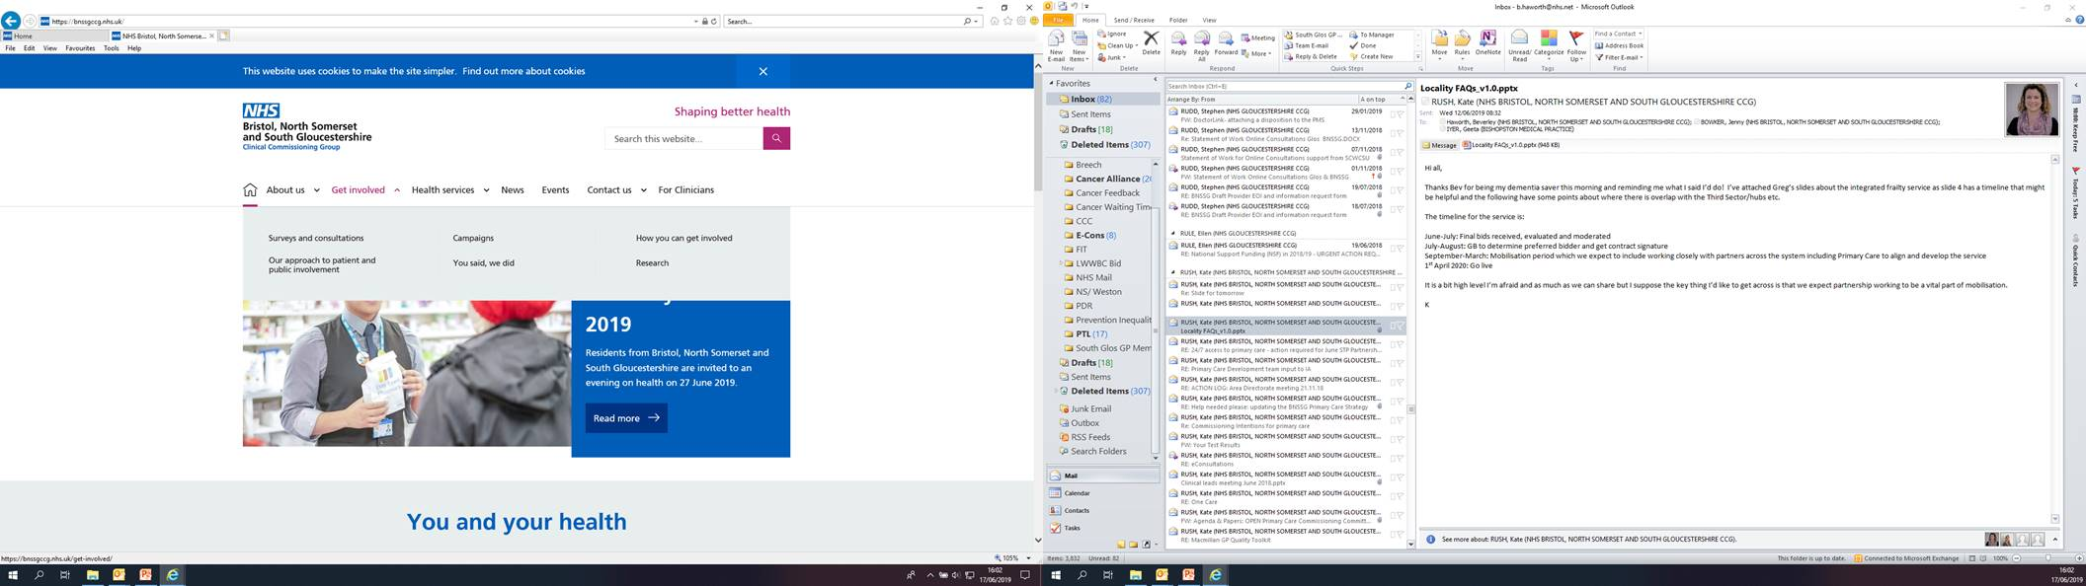
Get Involved
https://bnssgccg.nhs.uk

